Slide 1
Capstone Project Secure Data Hiding In Images Using Steganography
Presented By: Vikram Vyankatesh Pimprikar
Student Name: Vikram Vyankatesh Pimprikar
College Name: Sardar Patel Institute of Technology, Mumbai
Branch: Computer Science

Slide 2
OUTLINE
Problem Statement
Technology Used
Wow factors
End users
Result
Conclusion
Git-hub Link
Future Scope

Slide 3
Problem Statement
With the rise of digital communication, ensuring the confidentiality of sensitive information has become a critical challenge.
Traditional encryption methods, while effective, can attract attention and be subject to decryption attempts.
Steganography offers a covert approach by embedding secret messages within digital media, making them virtually undetectable.
This project leverages Least Significant Bit (LSB) steganography to hide and extract messages in images, providing a secure and inconspicuous method for confidential data transmission.

Slide 4
Technology Used
Programming Languages:
Python: The primary language for implementing LSB steganography due to its simplicity, flexibility, and extensive library support.
Libraries:
OpenCV (cv2) – Handles image processing operations such as reading, modifying, and saving images.
NumPy– Used for efficient array manipulation and pixel-level modifications.
Platform: Windows

Slide 5
Wow Factors
Invisible Data Embedding – Secret messages are hidden in images without noticeable visual changes.
Password-Protected Decryption – Ensures secure access to hidden messages.
Use of PNG to Prevent Data Loss – Avoids compression artifacts that could corrupt hidden data.
Fast and Efficient Processing – Uses optimized image and array manipulations for quick encryption and decryption.

Slide 6
END USERS
Cybersecurity Enthusiasts & Ethical Hackers
Journalists, and government agencies needing secure communication channels.
Researchers & Academicians studying cryptography, and steganography as part of cybersecurity research.
General users looking for enhanced digital security

Slide 7
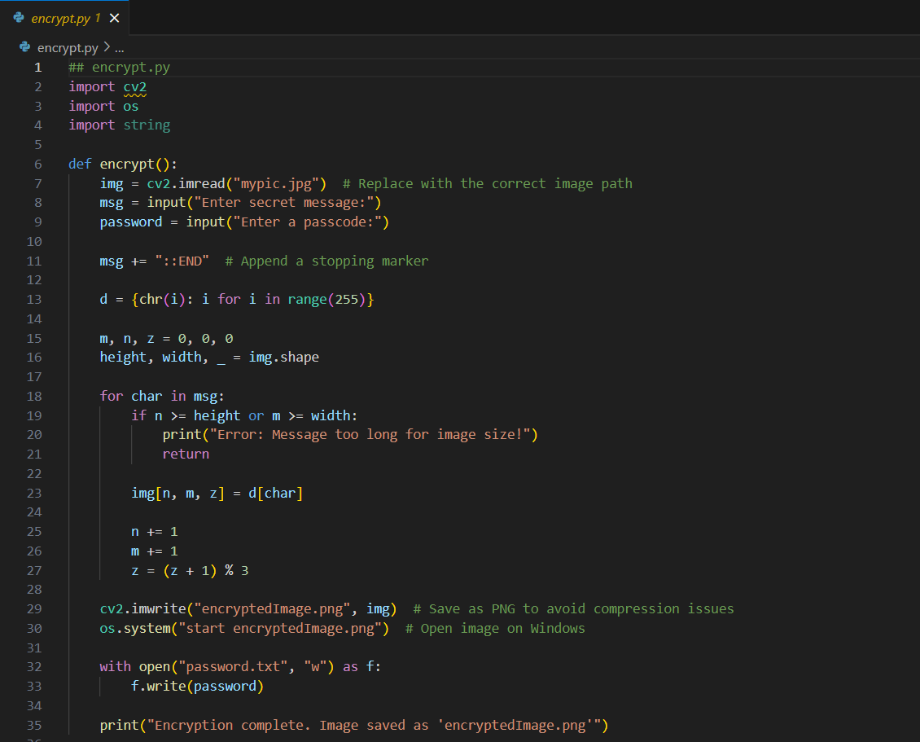

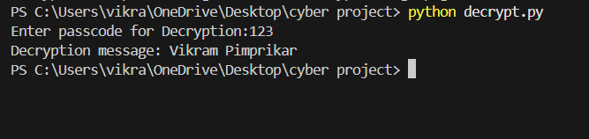
RESULTS

Slide 8
Conclusion
The LSB Image Steganography project provides a secure and efficient method for hiding and retrieving confidential messages within digital images. By leveraging Python, OpenCV, and NumPy, the project ensures seamless encoding and decoding while maintaining image quality. The use of password-based authentication enhances security, preventing unauthorized access to hidden data.
This project demonstrates the practical application of steganography in secure communication, digital forensics, and privacy protection. With its cross-platform compatibility and scalability, it can be further extended to support audio, video, and advanced encryption techniques.
Overall, LSB steganography is a powerful tool for covert data transmission, making it useful for cybersecurity professionals, journalists, businesses, and privacy-conscious individuals.

Slide 9
Git-Hub Link
https://github.com/VikramPimprikar/Secure-Data-Hiding-In-Image-Using-Steganography-.git

Slide 10
FUTURE SCOPE
Support for multiple image formats and higher resolution images.
Extend the approach to video steganography for dynamic data hiding.
Incorporate advanced encryption algorithms to further secure the hidden message.
Develop a web-based or mobile application for broader accessibility.

Slide 11
THANK YOU

